Slide 1
Molecular Simulation Toolkit
https://github.com/zhteg4pvt/nemd/
Main Contributor: Teng Zhang
Email: zhteg4@gmail.com

Slide 2
BSD 3-Clause License
Allow redistribution in any forms, with or without modification.
In short:
The general BSD 3-Clause copyright allows similar redistribution.
The software is provided as is and in no event shall the copyright holder or contributors be liable for any damages.
Neither the name of the copyright holder nor the names of its contributors may be used to endorse or promote products derived from this software without specific prior written permission.
Full Information in https://github.com/zhteg4pvt/nemd/tree/main/LICENSE

Slide 3
Installation
# Install Packages case $OSTYPE in darwin*) brew install gh git vim python@3.10 ;; linux*) sudo apt-get install -y gh git python3-pip ;; esac
# Clone code
gh auth login --hostname GitHub.com --web gh auth setup-git gh repo clone zhteg4pvt/nemd ~/git/nemd # Install drivers (lspci | grep VGA | grep -q -v NVIDIA) && exit 0 sudo ubuntu-drivers --gpgpu install sudo apt upgrade -y read -p "Driver installed. Reboot? [y/n]? " answer case "$answer" in Y|y) echo "rebooting..."; reboot ;; *) ;; esac echo "no reboot. (GPU driver may not be working)"
sh/setup
1)* bash -c "$(curl 'https://raw.githubusercontent.com/zhteg4/nemd/main/setup')"
2) cd ~/git/nemd; pip3.10 install . –v
class Distribution:
def run(self):
# Install packages self.prereq()
# Compile binaries self.compile()
# Distribute shell, python, and data self.setup()
def prereq(self): subprocess.run('brew install –q gcc', shell=True)
def compile(self): subprocess.run('bash install.sh', shell=True)
def setup(self):
setuptools.setup(
packages=[nemd, alamode], package_dir=[module/nemd], package_data={lammps: [build/lmp]}, scripts= =[sh/nemd_run])
setup.py
Name | OS | CPU | Graphic | Memory (GB) | setup (min) | pip (min) | test (min)
Mac Mini | Sonoma 14.6 | Apple M1 | Apple M1 | 8 | 3.94 | 5.11 | 0.77
Lenovo Y710 | Ubuntu 22.04.5 LTS | Intel® Core™ i7-6700 | GeForce GTX 1080 | 16 | 6.15 | 20.27 | 0.77
MacBook Pro | Sequoia 15.2 | Intel Core i5 | Intel Iris Plus 645 | 16 | 6.67 | 10.25 | 1.22
* Ubuntu: bash <(wget -qO- https://raw.githubusercontent.com/zhteg4/nemd/main/setup)
after factory reset

Slide 4
setup.py
class Darwin: """ macOS installer. """ def prereq(self, *pkgs): """ Install the packages required by compilation. """ if not self.lmp_exe: pkgs += self.LMP_PKGS cmd = ' '.join(self.INSTALL + pkgs) subprocess.run(f"echo {cmd}; {cmd}", shell=True) def compile(self): """ Compile the binaries. """ subprocess.run('bash install.sh', shell=True)
class Linux(Darwin): """ Linux installer. """ def prereq(self, *pkgs): """ Customize the prerequisites for Linux machine. """ info = subprocess.run('nvidia-smi | grep NVIDIA') if not info.returncode: pkgs += ('nvidia-cuda-toolkit’, ) super().prereq(*pkgs)
Installer = {'darwin': Darwin, 'linux': Linux}[sys.platform] class Distribution(Installer): """ Distribute the scripts, packages and data. """ def run(self): """ Main method to install and distribute. """ self.prereq()
self.compile() self.setup()
python3.10 setup.py install --verbose
Function | setuptools.setup
Module | packages = [nemd, alamode]
Python files | package_dir = {nemd: module/nemd}
Non-python | package_data= {lammps: [build/lmp]},
Scripts | scripts=[sh/nemd_run]
packages | install_requires=[numpy, scipy]
Metadata | classifiers=[Status :: Production/Stable]
site-packages/
bin/

Slide 5
Structure
Name | Description
sh | POSIX shell scripts
setup.py | PyPI installation on Darwin and Linux
module | Shared classes and functions
driver | Command line execution
workflow | Execution and aggregation
premake | Shell environmental configuration
test | Unit, integration, scientific, and performance
practice | Trial and error learning curve
docs | Roadmap, summary, and documentation

Slide 6
Architecture
initiation
module/nemd
Job & Log
System, Constant, Wrapper
Constant On Disk
Application Focused
Structure, Coordinate, and Force Field
Molecular Dynamics Trajectory Analysis
Lattice Dynamics
Driver Wrapper
Parallelization & Serialization
Polymer
Molecular Dynamics Log Analysis
Builder, Molecular Dynamics Simulation, MD Post Analysis, and Solid Physics
driver
Decentralized Automation
workflow

Slide 7
Architecture
module/nemd
initiation
debug, lazy_import (__init__ )
job & log
system, constant, wrapper
constant on disk
job registration (jobutils)
file logger (logutils)
builtins (builtinsutils)
system (osutils)
process (psutils)
time (timeutils)
environment (envutils)
constants (constants)
hardcoded (symbols)
numba (numbautils)
numpy (numpyutils)
rdkit (rdkitutils)
points (geometry)
matplotlib (plotutils)
periodic table (table)
Stillinger-Weber (sw)
lammps func (lmpfunc)
application focused modules
seeds in light blue
indicates dependence
(linear, branching, and merging)
centers and terminators in purple
dynamic force field (sw)
in script (lmpin)
lammps log (lmplog)
conformer, molecule, structure
(structure)
periodic boundary (pbc)
atomic data (lmpatomic)
trajectory (traj)
trajectory frame (frame)
opls data (lmpfull)
type & assign
(oplsua)
lattice dynamics (alamode)
crystal (xtal)
parser (parserutils)
visualization (molview)
distance (dist)
conformer search (structutils)
executable (process)
job, aggregator, task (taskbase)
log & traj (analyzer)
polymer (polymutils)
repeat unit (cru)
runner (jobcontrol)
driver & test tasks (task)
testing (test)
check (check)
driver
Builder : molecule (mol_bldr), amorphous (amorp_bldr), and crystal (xtal_bldr) Molecular Dynamics: LAMMPS runner (lammps)
Solid Physics: reciprocal space (recip_sp), phonon dispersion (dispersion) MD Post Analysis : log (lmp_log), trajectory (lmp_traj)
amorphous builder → molecular dynamics → trajectory analysis (ab_lmp_traj) crystal builder → molecular dynamics → log analysis (cb_lmp_log)
molecule builder → molecular dynamics → log analysis (mb_lmp_log) run command → check results → update tags (test)
workflow

Slide 8
Environmental Configuration
source premake sets the environment in which source code instead of installation is used.
# /bin/sh : ' Set up the environment for the module, sh, driver, workflow, and submodule directories. Usage: . premake source premake ‘
# Shell Type and Root Directory if [ $(basename $0) = 'premake' ] then NEMD_SRC="$0" && echo "zsh" elif [ $BASH_SOURCE ] then NEMD_SRC=${BASH_SOURCE[0]} && echo "POSIX" else x="$(lsof -p $$ -Fn0 | tail -1 | tr -d "\0")" && NEMD_SRC=${x#*n} && echo "dash" fi [ ! -f $NEMD_SRC ] && echo "Cannot locate the source root" && return NEMD_SRC="$(readlink -f ${NEMD_SRC} | xargs dirname)" && echo $NEMD_SRC
# Searchable Module: NEMD, LAMMPS, and ALAMODE add_pypath() { [ -d "$1" ] && echo $PYTHONPATH | grep -q "$1" && return export PYTHONPATH="$1${PYTHONPATH:+":$PYTHONPATH"}" } add_pypath $NEMD_SRC/module
# Searchable Script: Shell, Workflow, Driver, and Submodule path() {
[ -d "$1" ] && echo $PATH | grep -q "$1” || export PATH="$1${PATH:+":$PATH"}”
} add_path $NEMD_SRC/sh add_path $NEMD_SRC/driver add_path $NEMD_SRC/workflow add_path $NEMD_SRC/module/alamode/alamode/tools

Slide 9
Testing
Integration
Performance
Scientific
unit
Command | Location | Description | Goal
source premake | premake | Environmental configuration allows additional utilities, strongly recommended when opening a new shell. | Use the source code instead of the installation.
nemd_test | test/unit/ | Unit testing makes sure that functions and methods are operating as expected. (Bug-free for every piece) | Free of bugs when parameterizing every piece of the code.
nemd_itest | test/integration/ | Integration testing makes sure that scripts run without tracebacks and yield reproducible results. | Expected behavior and accuracy when driver and workflow combines pieces.
nemd_ptest | test/performance/ | Performance testing evaluates the speed, responsiveness and stability for bottleneck identification and nullification. | Resource efficiency on scaling up.
nemd_stest | test/scientific/ | Scientific testing ensures the repeatability, correctness and accuracy of the scientific outputs. | Physical meaning and standard deviation.
* source premake before running tests

Slide 10
Unit Testing
Run coverage analysis and generate report
nemd_cover | run analysis, create html, open browser
nemd_cover driver | analyze all driver tests
nemd_cover workflow test_workflow_test.py | analyze test_workflow_test.py only
nemd_cover module cru_test.py osutils_test.py | analyze multiple specific tests
Run unit tests
nemd_test | $NEMD_SRC/test/unit in parallel
nemd_test [file1 file2...] | specific tests
nemd_test -s -v [file1 file2...] | screen and verbose
nemd_test -m slow [file1 file2...] | selected tests marked with slow
Command | PYTEST | Dirname | Type | Results
nemd_cover | "-m ''" | workflow | statements missing excluded coverage | 200 0 8 100%
 |  | driver | statements missing excluded coverage | 466 0 16 100%
 |  | module | statements missing excluded coverage | 6088 0 164 100%
Command | PYTEST_ADDOPTS | Type | Result (num|sec) | Avg (sec)
nemd_test | "-m 'not slow'" | module driver workflow | 1732 | 14.71 129 | 6.13 43 | 4.25 | 0.0132
 | "-m slow" | module driver workflow | 1 | 20.19 1 | 3.95 no tests | 13.49
* source premake before running tests
Excluded: __main__, numba, platform-specific

Slide 11
Integration Test
file
cmd | Shell commands to run drivers and workflows
check | Shell commands to check the results against expectations
tag | Test tags in shell syntax (e.g., name, cost)
param | Parametrize one command into multiples
nemd_itest runs examples in test/integration/
Each test contains one cmd file, one check file, and one optional tag file.
The four-digit dirname is the test id.
cd test/integration/0049; head cmd check tag param
==> cmd <==
# Performance: [Ar] Amorphous Builder
nemd_run amorp_bldr_driver.py [Ar] -method grid -mol_num $param -seed 1
==> check <==
nemd_check collect task_time memory
nemd_check exist collect.csv collect.png
==> tag <==
slow 100.0 00:00:04 50000.0 00:00:05
label number_of_molecules
==> param <==
# Number of Molecules
100
50000
Check Command
general shell cmd | echo, [ -f file ], &&, ||, ( grep pattern file ), etc.
nemd_check exist | File existence
nemd_check glob | Match number from pattern expansion
nemd_check has | Specific strings in file
nemd_check cmp | Content comparison
nemd_check collect | Collect information from log files
Tag Key
label | The script name (-NAME in the .log)
slow | The time cost on execution
Param Format
comment | The str after # names the parameter
parameter | Replace the $param in cmd to generate command(s)

Slide 12
test_workflow.py
Supported arguments | Description
-name {integration,performance,scientific} | integration: reproducibility performance: resource efficiency scientific: physical meaning
ID | Select the tests of these ids
-dirname DIRNAME | Search test(s) under this directory
-slow SECOND | Skip (sub)tests marked with time longer than this criteria
-label LABEL [LABEL ...] | Select the tests marked with the given labels
-task {cmd,check,tag} | cmd: run the commands in the cmd file check: check & collect the results tag: update the tag file (e.g., time, name)
-jtype {task,aggregator} | task: run tasks and register outputs aggregator: collect results
-cpu CPU [CPU ...] | Total number of CPUs [the CPUs for one task] Each task uses 1 CPU If per-task CPUs not provided
-screen {off,serial,parallel,job} | Print the serialization tqdm, parallelization progress, and job details
-DEBUG [{True,False}] | True: enable debug mode for the workflow and sub-jobs False: disable the mode
-copy | Copy test data into the working directory

Slide 13
Integration Test | method/driver | Molecule/Polymer | Structure | Comment
1 | grid | 1 | CC(C)O | Single
2 | mol_bldr | 2(2) | CCCC (120) | Set Geom
3 | mol_bldr | 1(3) | CCC | Measure
4 |  | 1 | 10 | CCCCCC(C)O [Ar] | Mol | Mol
5 | Pack | 1 | CC(=O)O | Single
6 |  | 11(6) | *CC* | Polym
7 |  | 11(6) | *CC* | Reduced Density
8 | Grow | 10 | C | Mol
9 |  | 1 | 1 | O CCCO | Mol | Mol
10 |  | 3(5) | *CC(O)* | Polym
11 |  | 5(3) | 15 | *CC(*)C(=O)O CN(C)C=O | Polym | Mol
12 |  | 5(5) | *CC* | Relocation
13 |  | 10 | 10 | [Ar] CCCC | Failed Initialization
14 |  | 1(200) | *CC* | Single Long
15 |  | 10(100) | *CC(*)C(=O)O | Multi Long
16 |  | 1 | O | TIP3P
17 |  | 1 | O | SPCE
18 |  | 1 | O | SPC
19 |  | 1 | CO
20 |  | 1 | CCO
21 |  | 1 | CC(=O)C
22 |  | 1 | CCC(=O)CC
23 |  | 1 | CC(C)(C)C
24 |  | 1 | CC(C)CC(=O)C(C)(C)C
25 |  | 1 | 1 | O CCCO
26 |  | 10 | [Li+].[F-]
27 |  | 10 | [Na+].[Cl-]
28 |  | 5 | [Br-].[Mg+2].[Br-]
29 |  | 10 | [K+].[Br-]
30 |  | 5 | 5 | [Rb+].[Cl-] [Cs+].[Br-]
31 |  | 5 | 5 | 5 | 5 | 5 | [He] [Ne] [Ar] [Kr] [Xe]
32 |  | 1 | 1| 1| 6 | [Ca+2] [Sr+2] [Ba+2] [Cl-]
33 | xtal_bldr | 1x2x3 supercell | Si (face centered-cubic) | Scale Factor 0.95
52 |  | 1 | "C*.*CC*.C*" | inr, mono, ter
53 |  | 1 | "[*:1]C([*:1])([*:1]).*C*" | inr with multiple stars
54 |  | 1 | "*C" | terminator only
55 |  | 1 | "[*:1]C([*:1])[*:1]" | initiator only
56 |  | 1 | "[*:1]C([*:1])[*:1].C*" | initiator, terminator
57 |  | 1 | 0 | No Relaxation
49 |  | 1 | [Ar] | Performance (mol num)
58 |  | 1 | [Ar] | Performance (Press)
Builder
amorp_bldr_driver.py builds polymers from constitutional repeat units, and packs molecules into an amorphous cell.
CRU: initiator, monomer, terminator, and regular molecule
-method grid: grid the space and put molecules into sub-cells
-method pack: randomly rotate and translate molecules
-grow: grow molecules from the smallest rigid fragments
mol_bldr_driver.py builds single polymer or molecule via the grid method.
-substruct SMILES (VALUE): set or measure the substructure geometry
xtal_bldr_driver.py generates crystal supercell with scaled lattice vectors.
-name Si: diamond cubic structure (space group 227)
-dimension [DIMENSION ...] : duplicate by these factors to generate the supercell
Only Stillinger-Weber potential supported
Integration test
single molecule or polymer (with part of the geometry set or measured)
multiple molecules and (or) polymers at target or reduced densities
various structures and long polymers
Crystal structure with scaled lattice
amorp_bldr_driver.py as driver unless noted otherwise
composition separated by |, repeat unit number inside (), polymerization capping atoms as *

Slide 14
Decentralized Automation
From different seeds, ab_lmp_traj_workflow.py builds amorphous structure, runs simulation, and analyzes the trajectory.
mb_lmp_log _workflow.py builds molecules with different geometries, calculates single point energy, and analyzes the log file.
With lattice vectors scaled differently, cb_lmp_log_workflow.py builds crystal structure, run simulations, and analyzes the log file
Molecular Dynamics
lammps_driver.py runs molecular dynamics simulations.
GPU auto-detection.
-cpu NUM: multiple CPU threads via OPENMP.
lmp_log_driver.py analyzes the log from previous molecular dynamics simulations.
-task {...}: temperature , pairwise energy, molecular energy, total energy, pressure, volume
lmp_traj_driver.py analyzes the trajectory from molecular dynamics simulations.
-task {...}: radial distribution function (RDF), density, clash, XYZ, diffusion coefficient via mean squared displacement (MSD), and visualization
-PYTHON {0,1,2} 0: native python; 1: compiled Numba; 2: the cached Numba
Solid Physics
recip_sp_driver.py plots direct and reciprocal lattice of Hexagon (graphene).
-miller_indices [...]: Miller Indices defines the plane and norm
dispersion_driver.py calculates and plots phonon dispersion.
-name {Si} : Name to retrieve the crystal structure from the database
Integration Test | Driver/Workflow | Comment
34 | lammps | Single GPU on Ubuntu; Multiple CPUs on macOs
35 | lammps lmp_log | Serial Driver Jobs: Molecular Dynamics, Log Analyzer
36 | lmp_log | Thermodynamic Data Analyzer
37 | lmp_traj | RDF, Density, Clash, XYZ, MSD and visualization
51 |  | No datafile
38 |  | All-pair RDF
39 |  | Neighbor RDF using Original Python
40 |  | Neighbor RDF using Compiled Numba
41 |  | Neighbor RDF using Cached Numba
42 |  | Neighbor RDF using Uncompiled Numba
43 | recip_sp | Real Space Plane Norm = 2π / Reciprocal Vector Summation
44 | dispersion | Primitive Cell, Symmetry, Force Constant, and K-Path
45 | ab_lmp_traj | Ar Amorphous, Berendsen NPT, Density (2 replica)
50 |  | Single atom and Single frame
46 | mb_lmp_log | The energy hypersurface
47 | mb_lmp_log | Geometry measurement
48 | cb_lmp_log | Energy vs Scale Factor

Slide 15
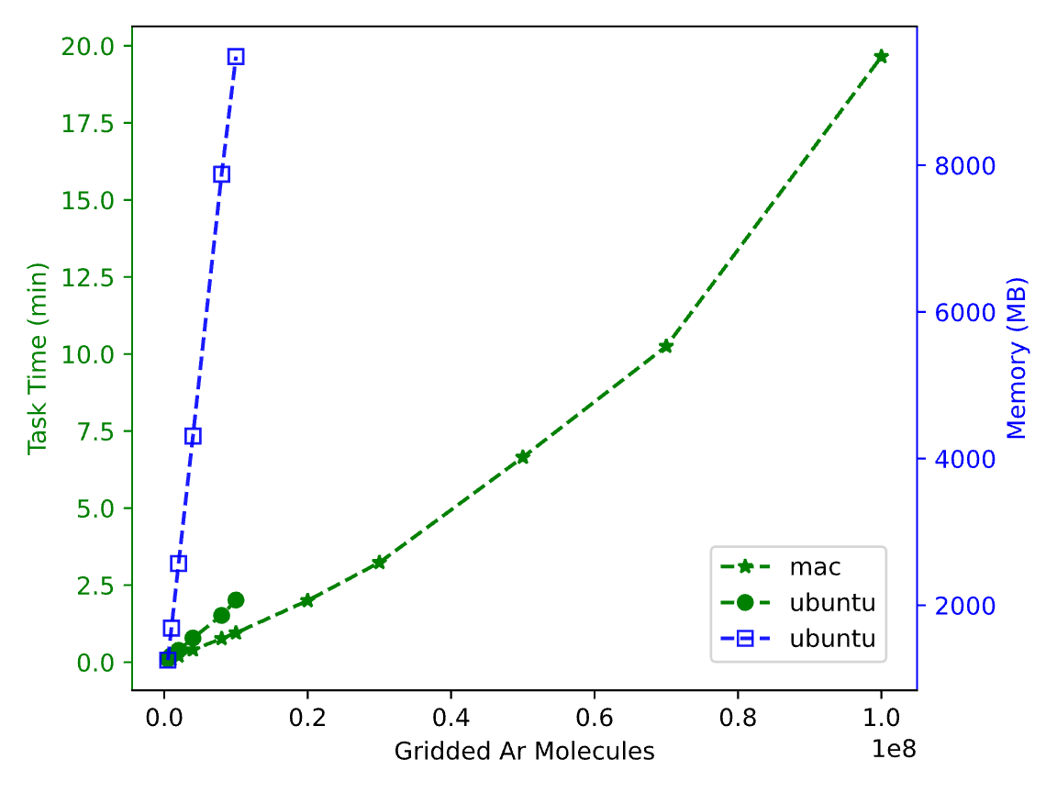
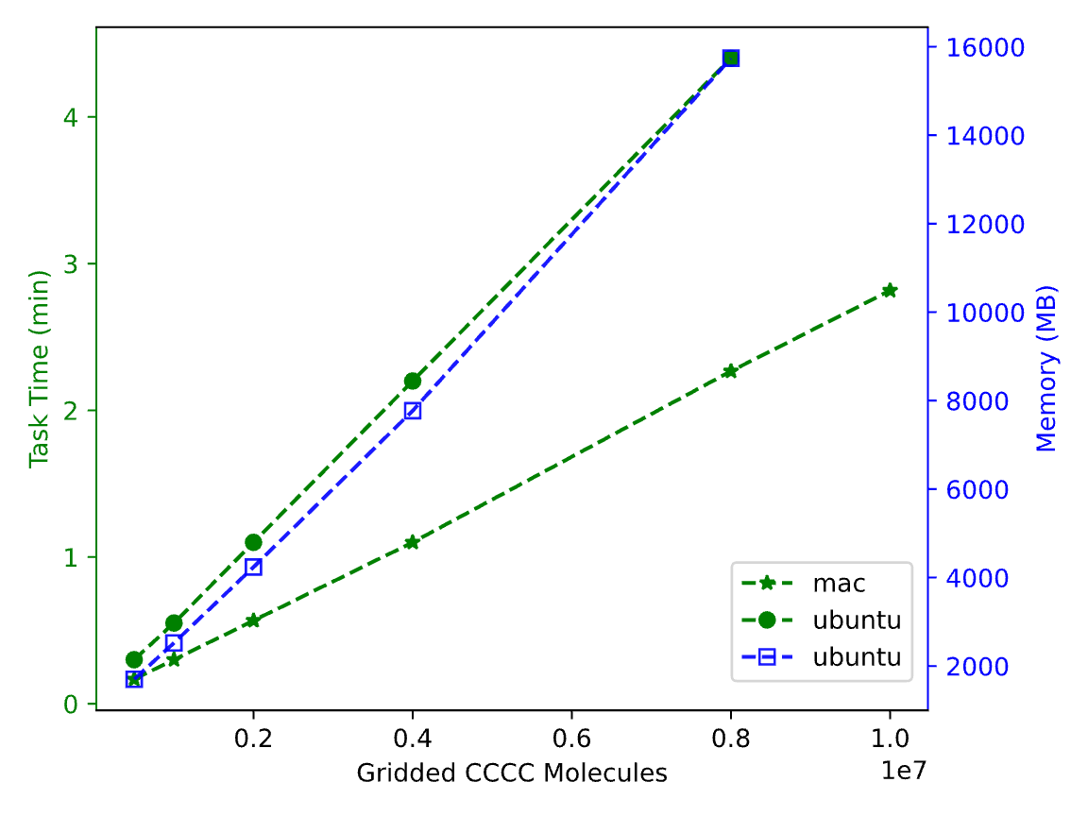
Performance Test
macOS Sequoia 15.6.1, Apple M4, 16GB LPDDR5
Ubuntu 22.04.5 LTS, i5-11400F, RTX 3060 Ti, 16GB
01: Gridded Amorphous Argon
02: Gridded Amorphous Butane
20 min: 100 million Ar
2.82 min
10 million butane
0.5 g/cm³ & 0.5 radius

Slide 16
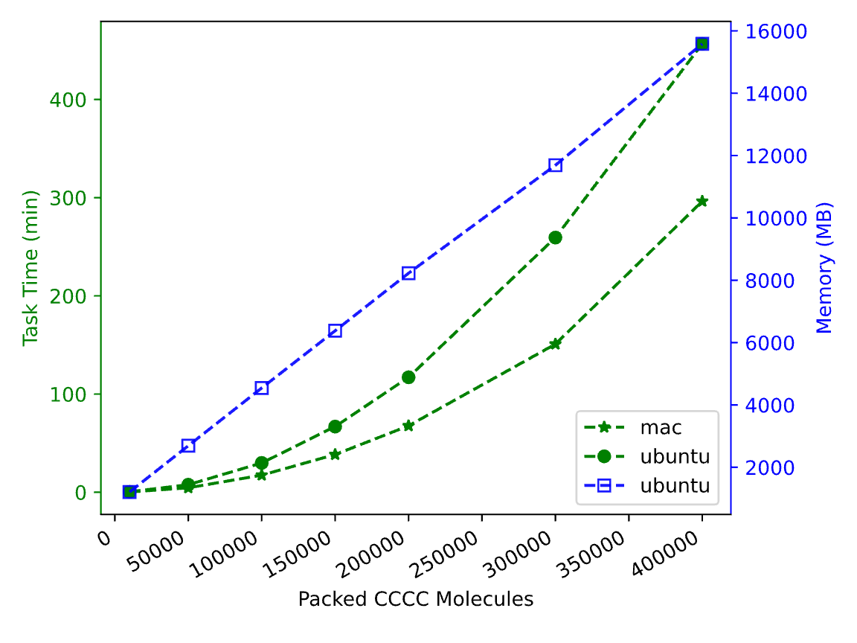
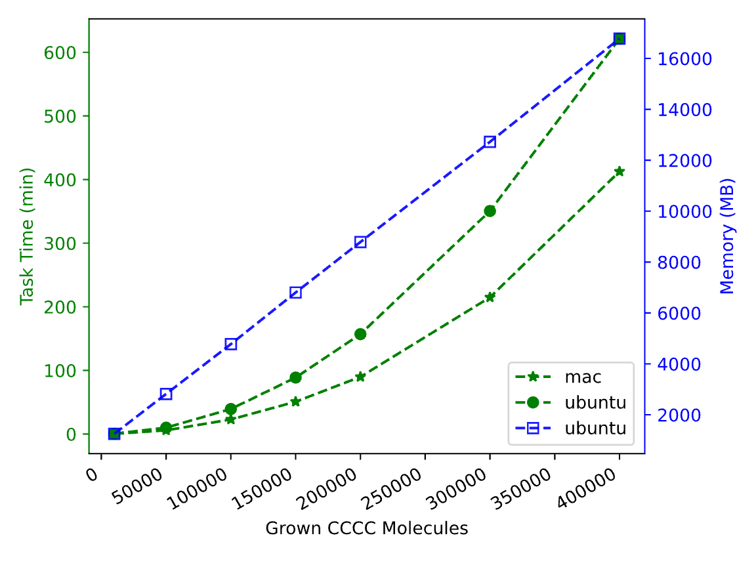
Performance Test
macOS Sequoia 15.6.1, Apple M4, 16GB LPDDR5
Ubuntu 22.04.5 LTS, i5-11400F, RTX 3060 Ti, 16GB
03: Packed Amorphous Argon
04: Grown Amorphous Butane
4.94 h: 0.4 million Ar
6.88 h: 0.4 million Ar
0.5 g/cm³ & 0.5 radius

Slide 17
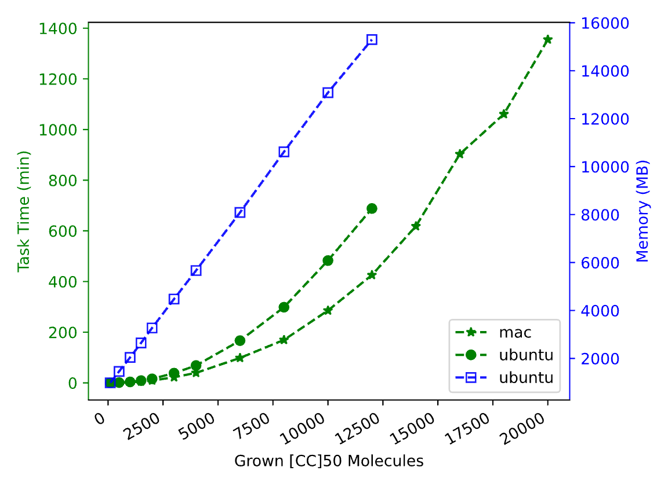
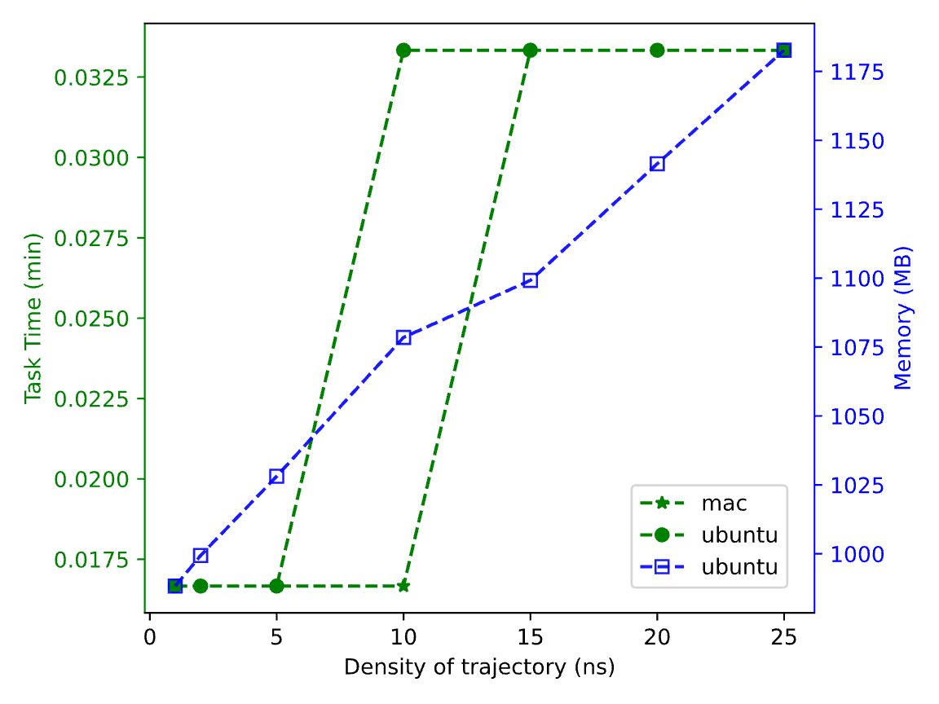
Performance Test
macOS Sequoia 15.6.1, Apple M4, 16GB LPDDR5
Ubuntu 22.04.5 LTS, i5-11400F, RTX 3060 Ti, 16GB
05: Packed Amorphous Polyethylene
06: Trajectory Density
22.59 h
20,000 (−CH2−)₁₀₀
2 s / 200 MB
25,000 frames
0.5 g/cm³ & 0.5 radius
100 hexane per frame

Slide 18
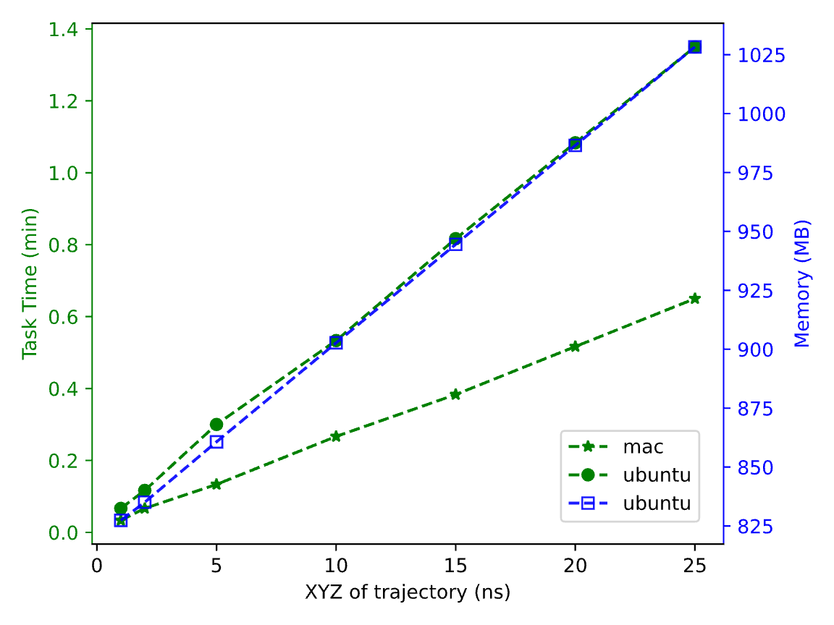
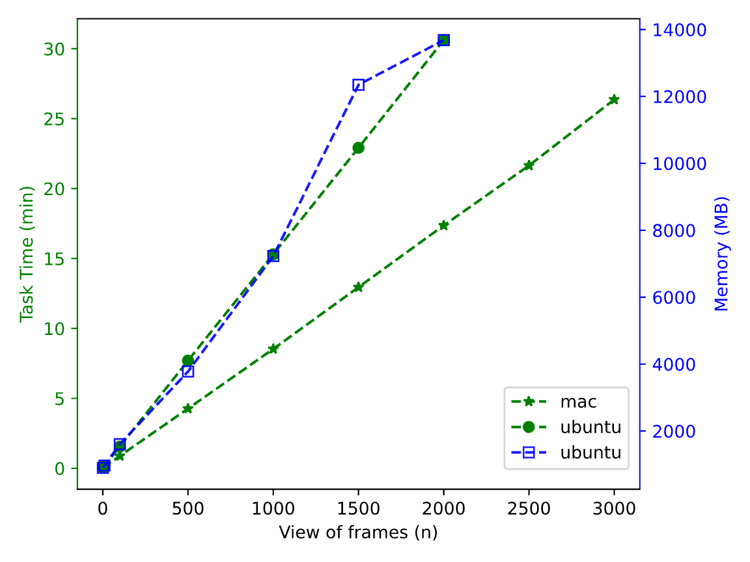
Performance Test
macOS Sequoia 15.6.1, Apple M4, 16GB LPDDR5
Ubuntu 22.04.5 LTS, i5-11400F, RTX 3060 Ti, 16GB
07: Trajectory XYZ writer
08: Trajectory HTML View
26.37 min
3,000 frames
0.65 min / 200 MB
25,000 frames
100 hexane per frame

Slide 19
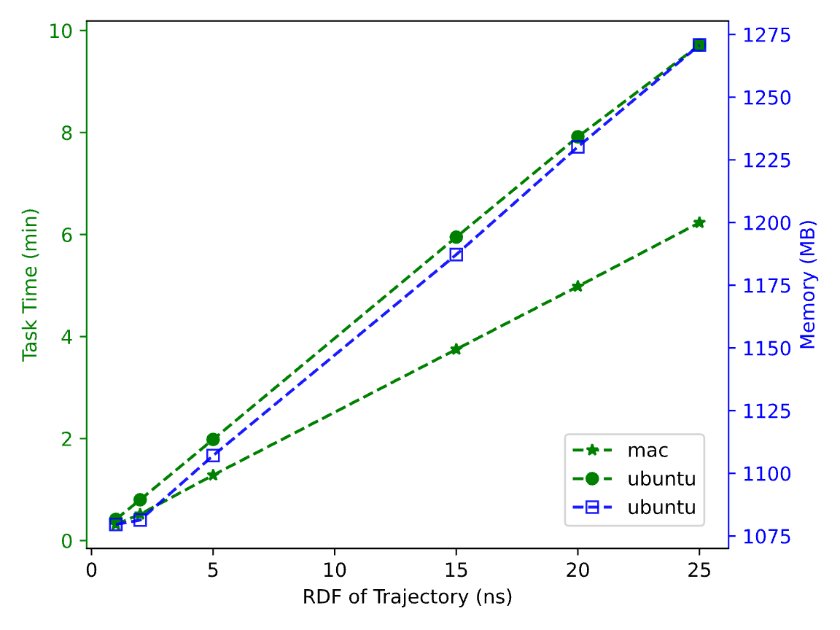
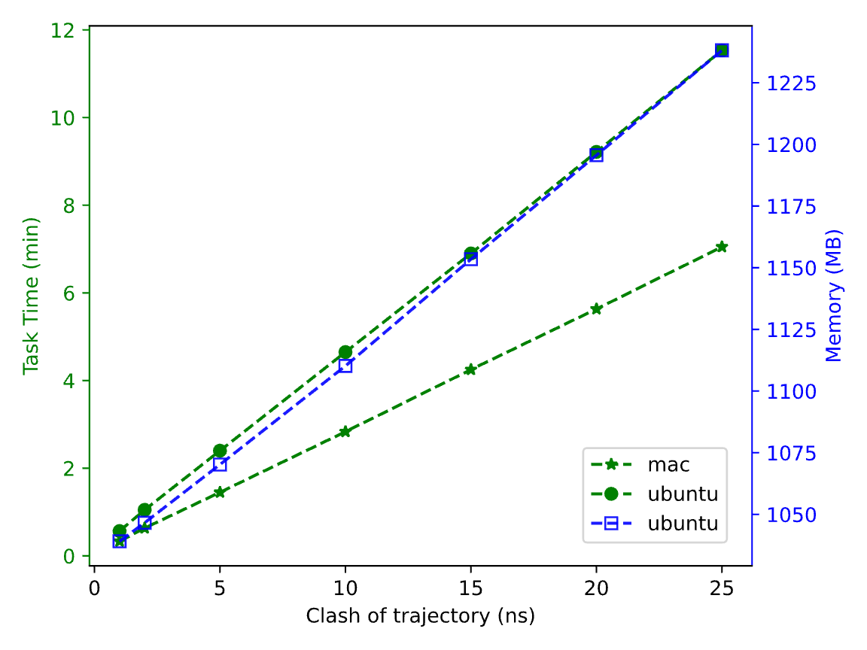
Performance Test
macOS Sequoia 15.6.1, Apple M4, 16GB LPDDR5
Ubuntu 22.04.5 LTS, i5-11400F, RTX 3060 Ti, 16GB
09: Trajectory Radial Distribution Function
10: Trajectory clash count
6.23 min / 191 MB
25,000 frames
7.05 min / 190 MB
25,000 frames
100 hexane per frame

Slide 20
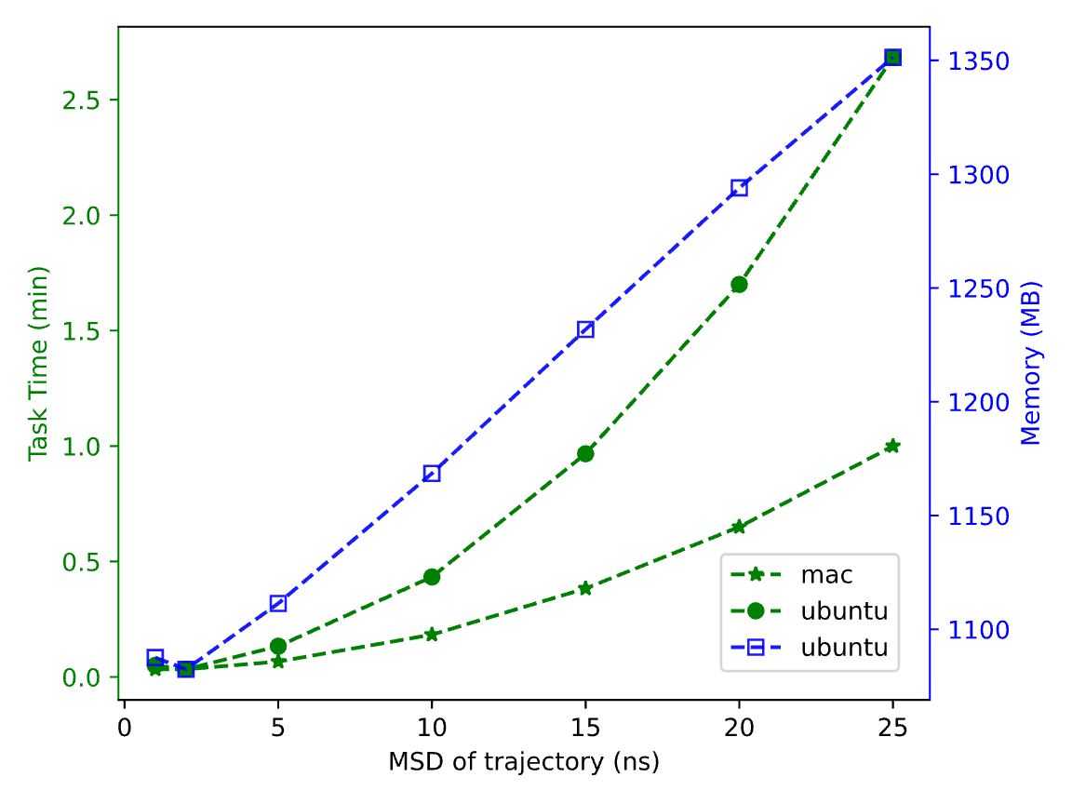
Performance Test
macOS Sequoia 15.6.1, Apple M4, 16GB LPDDR5
Ubuntu 22.04.5 LTS, i5-11400F, RTX 3060 Ti, 16GB
11: Trajectory Mean Squared Displacement
2.68 min / 264 MB
25,000 frames
100 hexane per frame

Slide 21
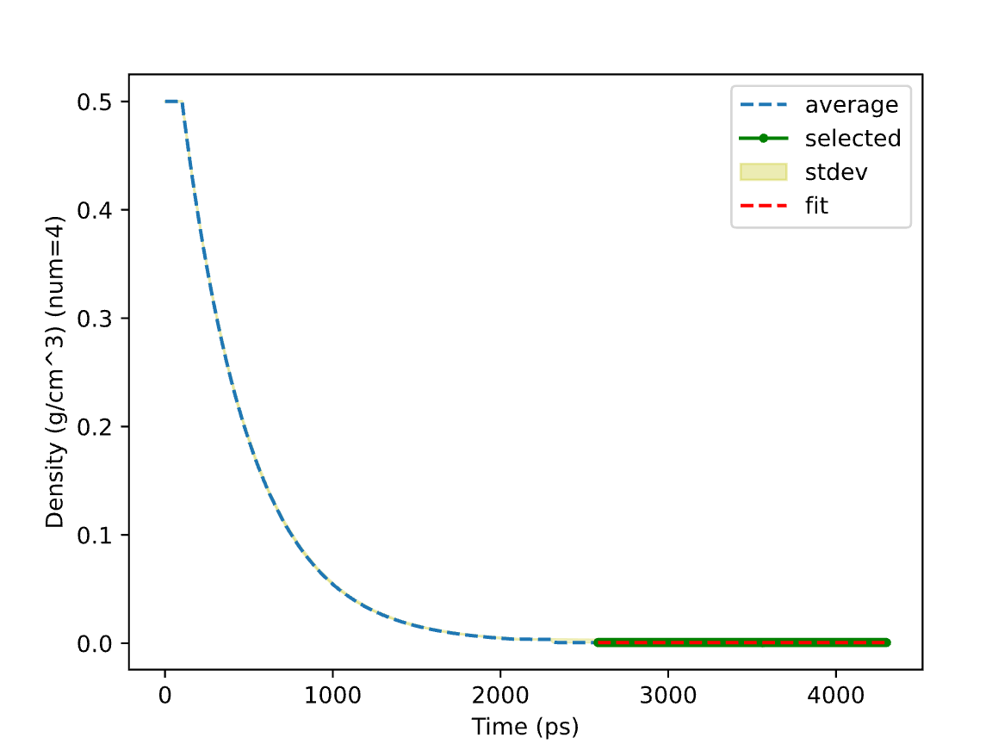
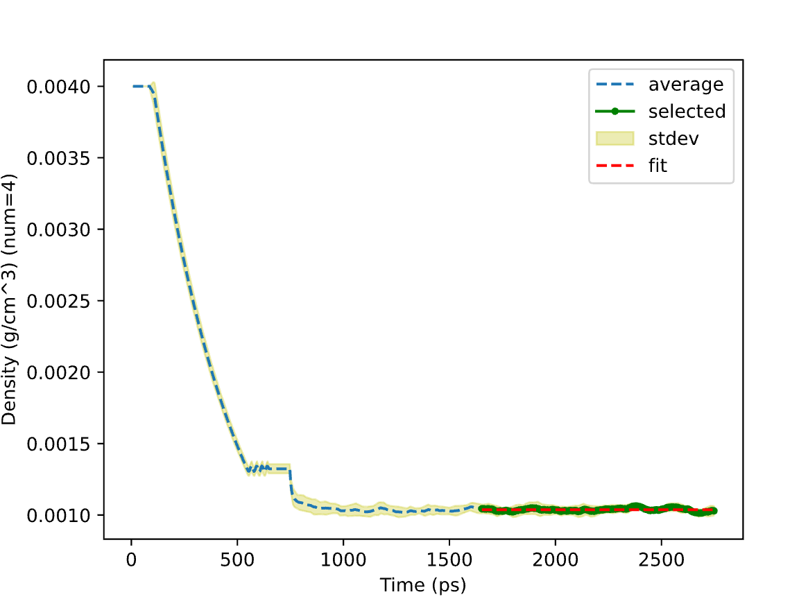
Scientific Test
https://en.wikipedia.org/wiki/Methane
https://www.engineeringtoolbox.com/ethane-C2H6-density-specific-weight-temperature-pressure-d_2088.html
01: Methane Gas Density
02: Ethane Gas Density
0.660 vs 0.657 kg/m³
(25 °C, 1 atm from ref)
1.038 vs 1.214 kg/m³
(300K, 1 bara from ref)
4 independent runs by random seeds:
a) Amorphous built with high density (0.5 g/cm³)
b) Molecular dynamics (Berendsen at 300 K and 1 atm)
c) Density analysis of trajectory frames
4 independent runs by random seeds:
a) Amorphous built at a density of 0.004 g/cm³
b) Molecular dynamics (Berendsen at 300 K and 1 atm)
c) Density analysis of trajectory frames

Slide 22
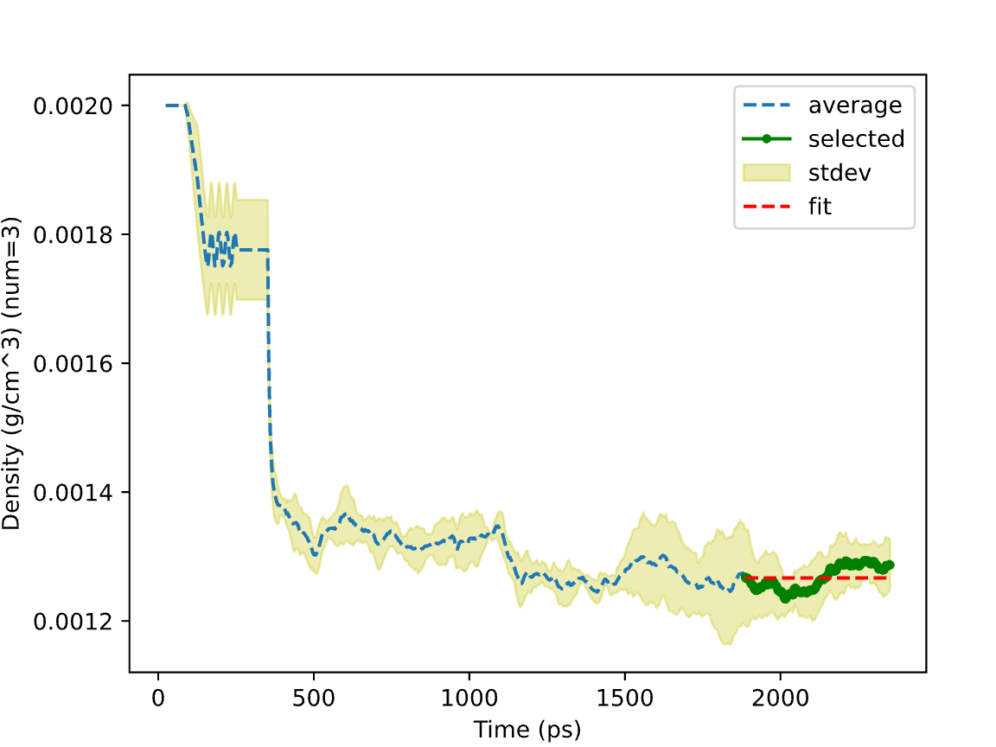
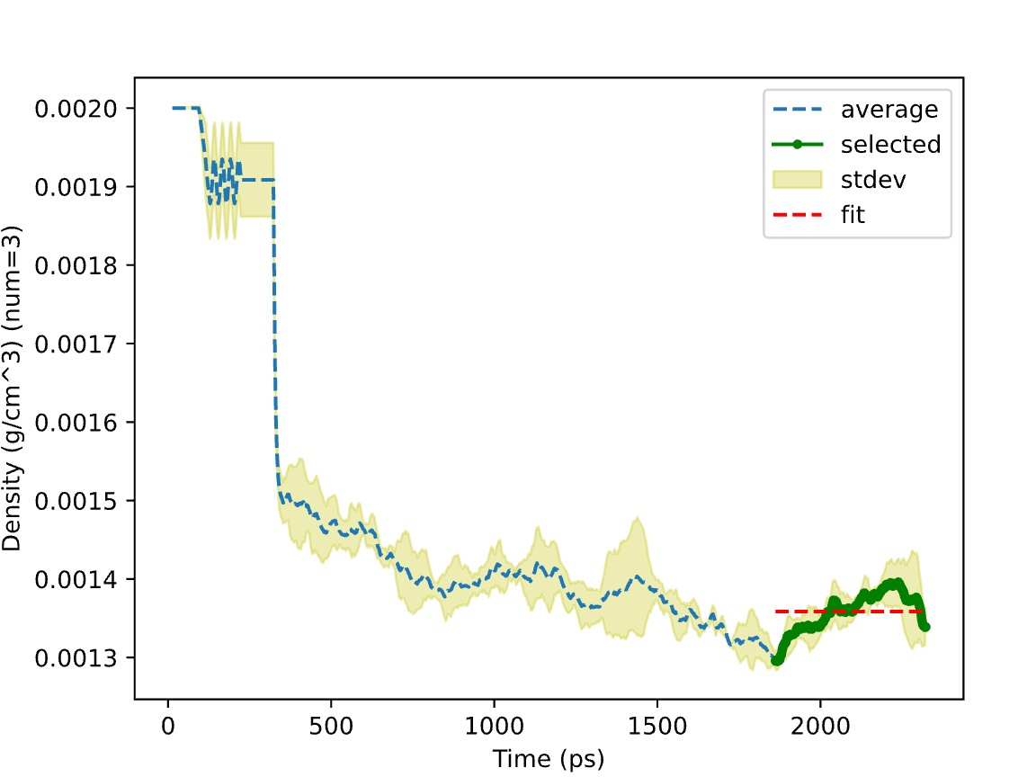
Scientific Test
https://en.wikipedia.org/wiki/Propane
https://www.engineeringtoolbox.com/butane-density-specific-weight-temperature-pressure-d_2080.html
03: Propane Gas Density
04: Butane Gas Density
1.267 vs 1.808 kg/m³
(0 °C, 101.3 kPa from ref)
1.359 vs 2.400 kg/m³
(300K, 1 bara from ref)
Amorphous Built (0.002 g/cm³) → Molecular Dynamics (Berendsen at 300 K and 1 atm) → Density Analysis

Slide 23
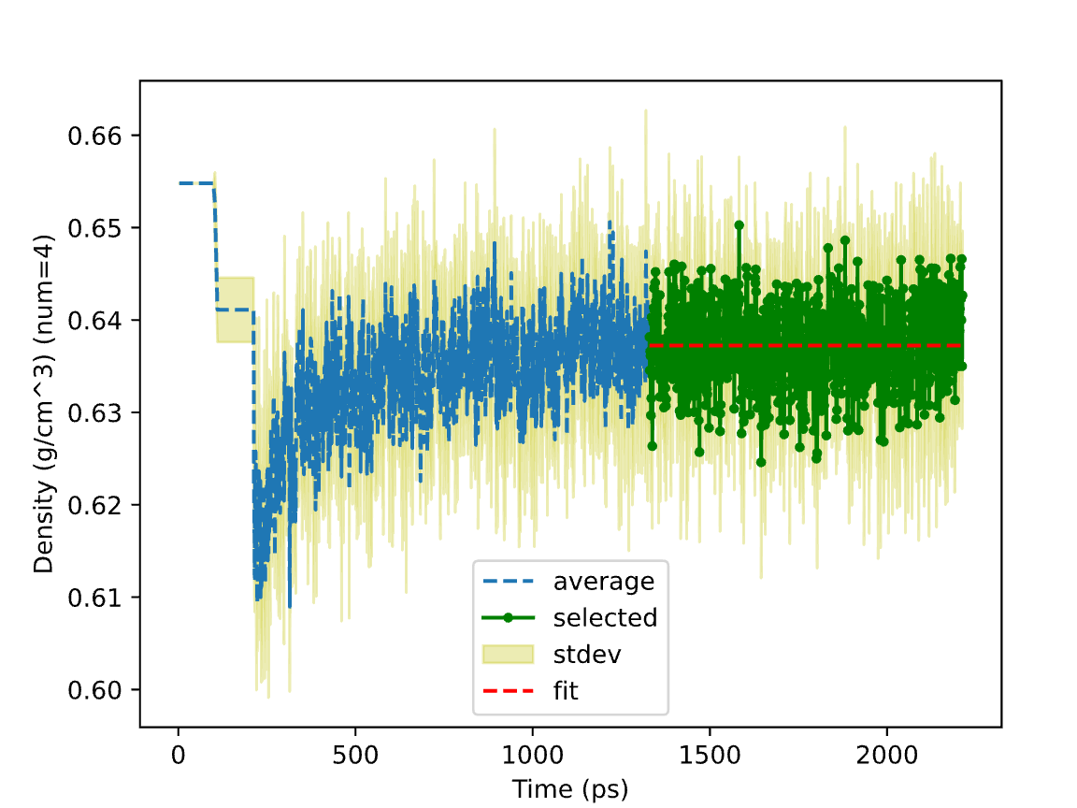
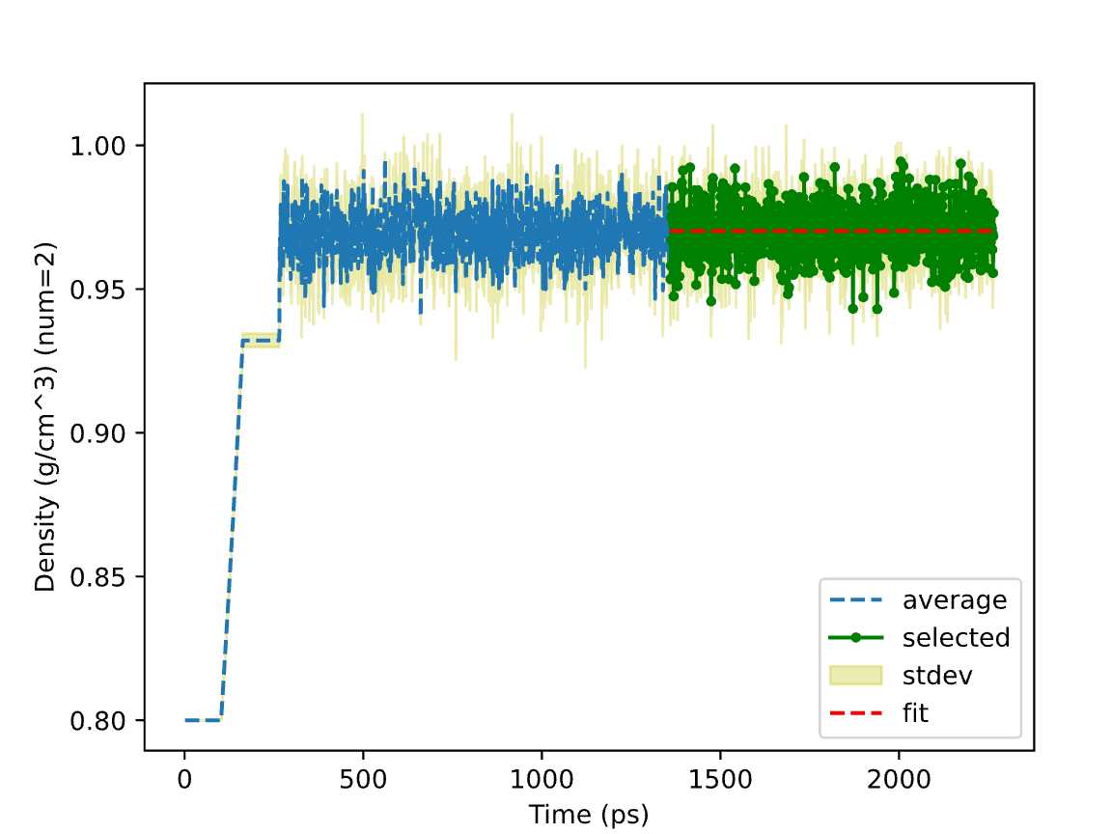
Scientific Test
https://macro.lsu.edu/HowTo/solvents/hexane.htm
https://www.vip-ltd.co.uk/Expansion/Density_Of_Water_Tables.pdf
07: Hexane Liquid Density
08: SPC Water Liquid Density
0.6372 vs 0.6548 g/cm³
(25 °C from ref)
0.9702 vs 0.9971 g/cm³
(25 °C, 1 atm from ref)
4 independent runs by random seeds:
a) Amorphous builder at a density of 0.6548 g/cm³
b) Molecular dynamics (MTK at 300 K and 1 atm)
c) Density analysis
2 independent runs by random seeds:
a) Amorphous builder at density of 0.8 g/cm³
b) Molecular dynamics (MTK at 300 K and 1 atm)
c) Density analysis

Slide 24
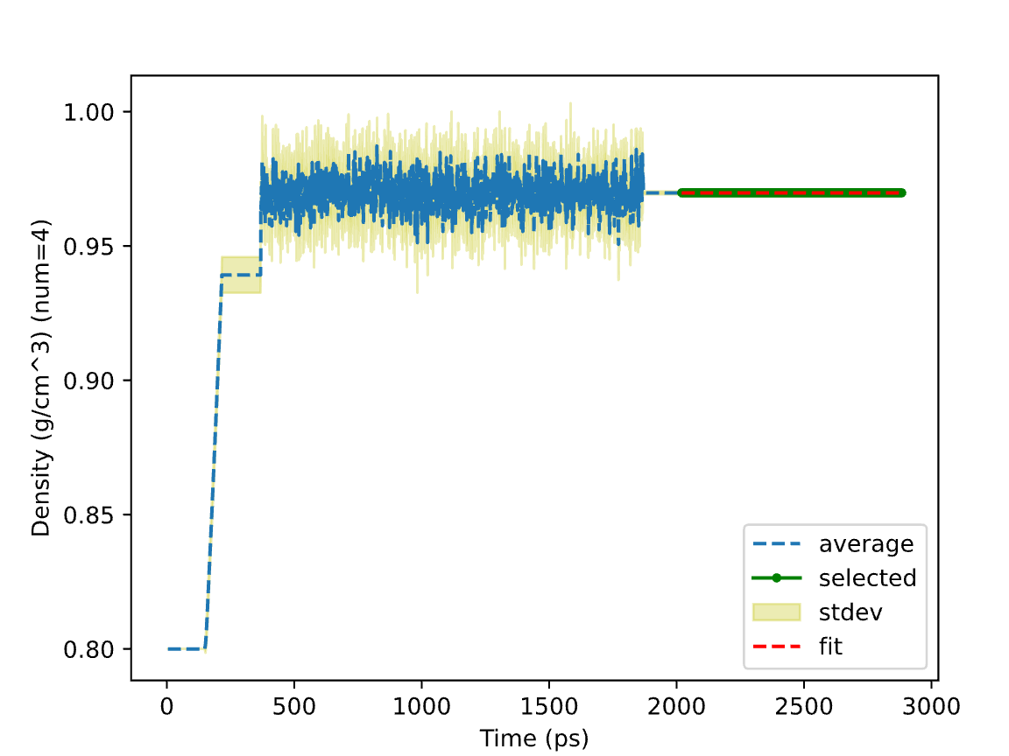
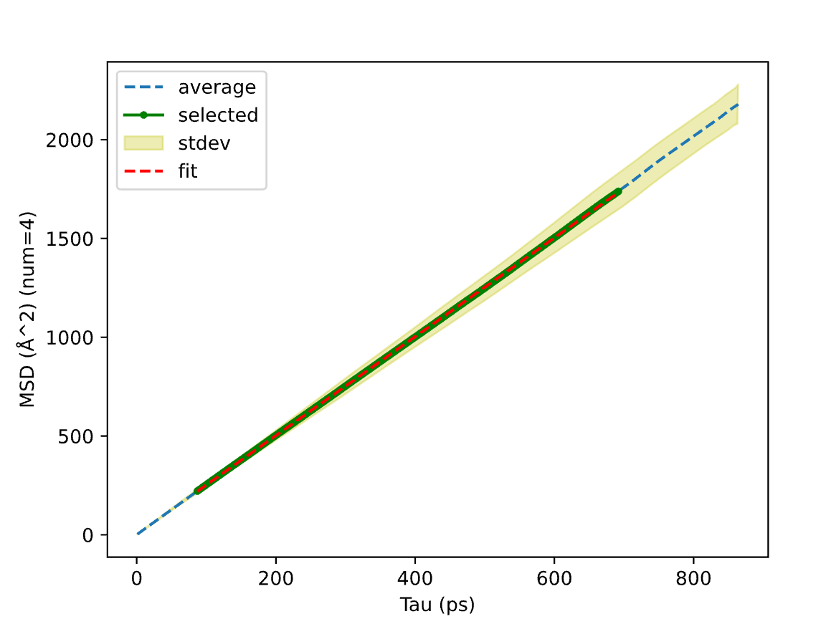
Scientific Test
J. Chem. Inf. Model. 2021, 61, 9, 4521–4536
09: SPC Water Liquid Density and Mean Squared Displacement
0.970 vs 0.972 g/cm³
(298.15 K, 1.0 atm)
f
d
e
g
c
a) NVT from low temp to target temp
b) Deform the box to match the press
c) NVT relaxation
d) NPT at target press and temp
e) Average the box
f) NVT relaxation
g) NVE production
b
Diffusion Coefficient
4.17e-05 vs 4.32e-05 cm²/s
(298.15 K, 1.0 atm from ref)
a
1 Seeded Amorphous Builder → Molecular Dynamics → Density and Mean Squared Displacement analyses
2 …
3 …
4 …
Fit and Report
merge

Slide 25
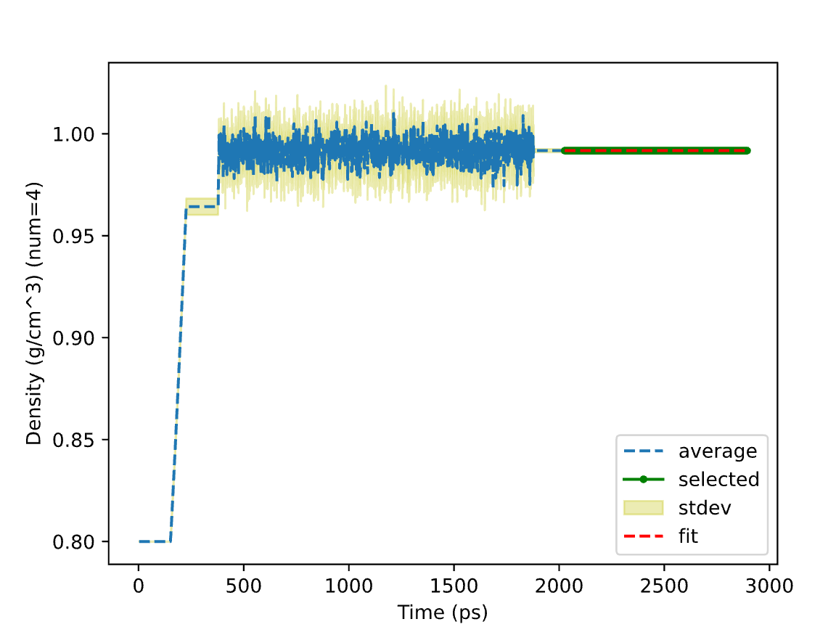
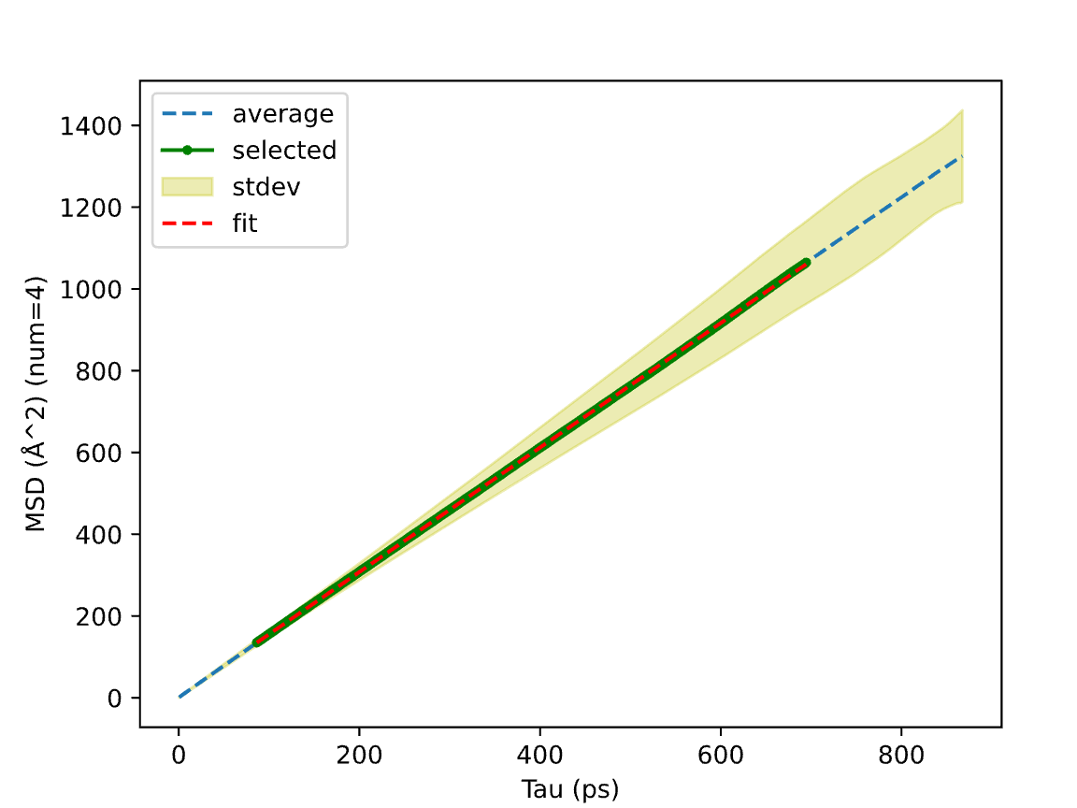
Scientific Test
J. Chem. Inf. Model. 2021, 61, 9, 4521–4536
10: SPCE Water Liquid Density and Mean Squared Displacement
0.992 vs 0.993 g/cm³
(298.15 K, 1.0 atm from ref)
Diffusion Coefficient:
2.54e-05 vs 2.60e-05 cm²/s
(298.15 K, 1.0 atm from ref)
1 Seeded Amorphous Builder → Molecular Dynamics → Density and Mean Squared Displacement Analyses
2 …
3 …
4 ...
Fit and Report
merge

Slide 26
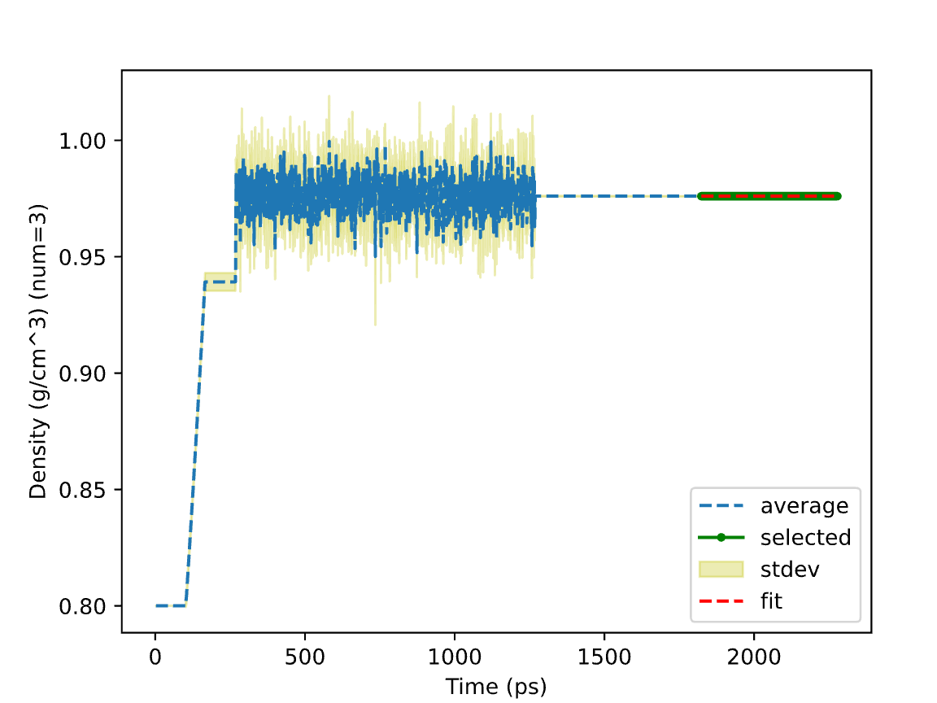
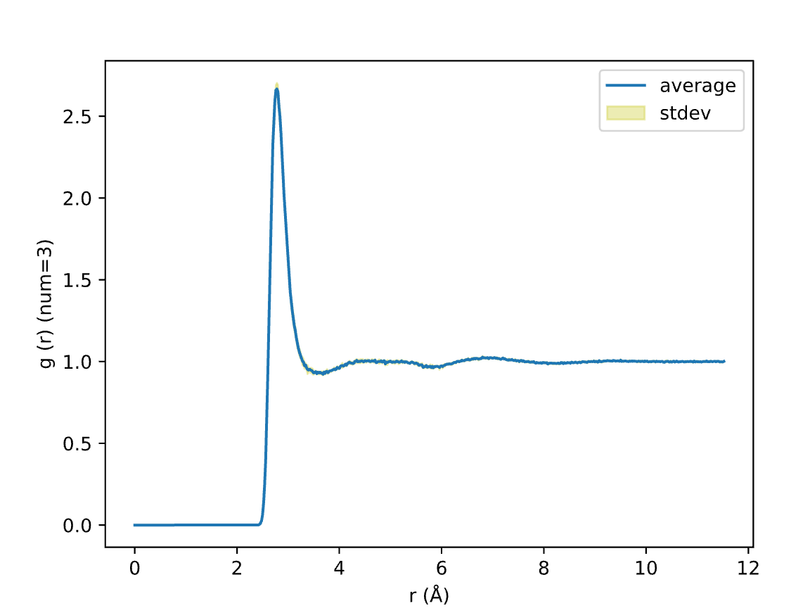
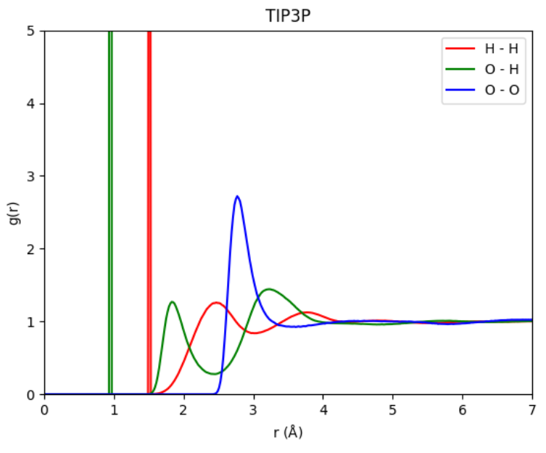
Scientific Test
J. Chem. Inf. Model. 2021, 61, 9, 4521–4536
11: TIP3P Water Liquid Density and Radial Distribution Function
from ref
0.976 vs 0.980 g/cm³
(298.15 K, 1.0 atm from ref)
1 Seeded Amorphous Builder → Molecular Dynamics → Density and Radial Distribution Function Analyses
2 …
3 …
Fit and Report
merge

Slide 27
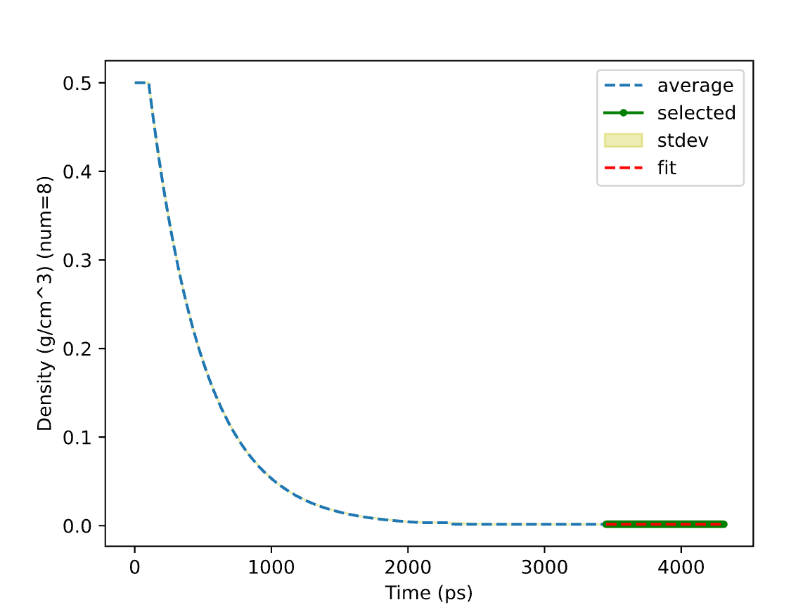
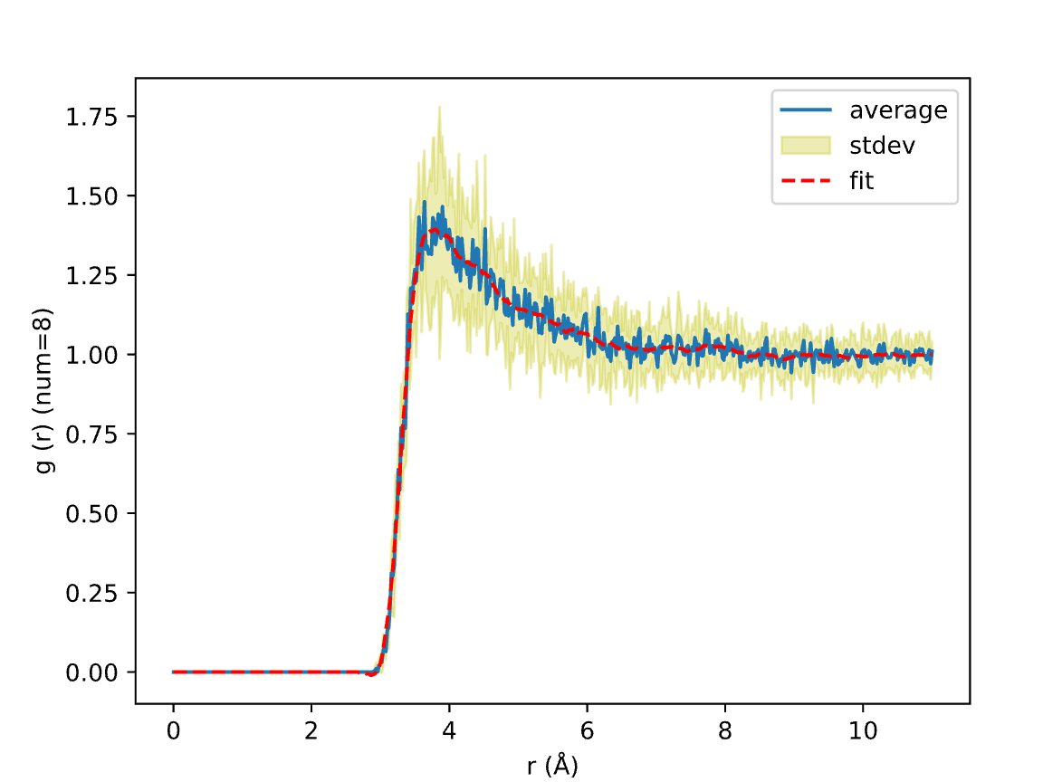
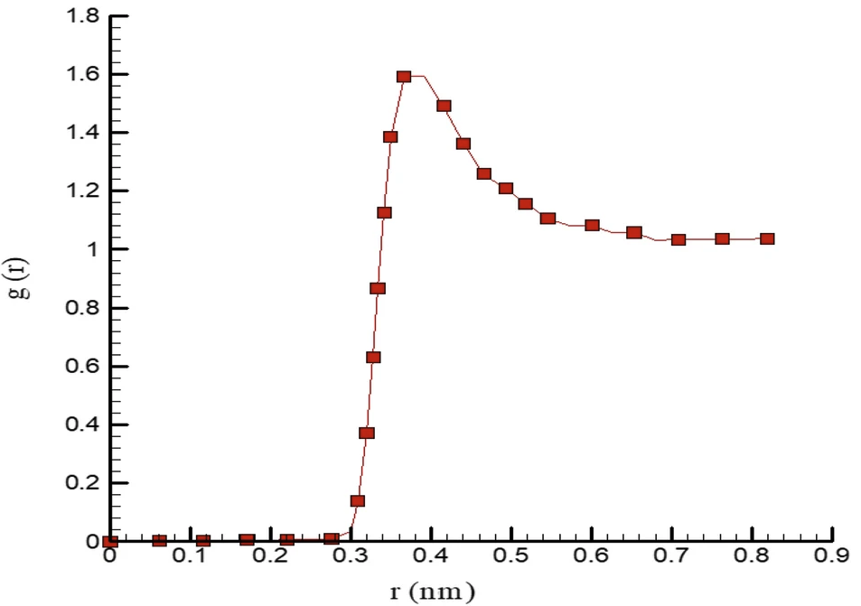
Scientific Test
https://www.engineeringtoolbox.com/argon-density-specific-weight-temperature-pressure-d_2089.html
Scientific Reports 2021 11:16912
12: Argon Gas Density and Radial Distribution Function
1.625 vs 1.603 kg/m³
(300 K, 1 bara from ref)
from ref
1 Seeded Amorphous Builder → Molecular Dynamics → Density and Radial Distribution Function Analyses
2 …
⋮
8 …
Fit and Report
merge

Slide 28
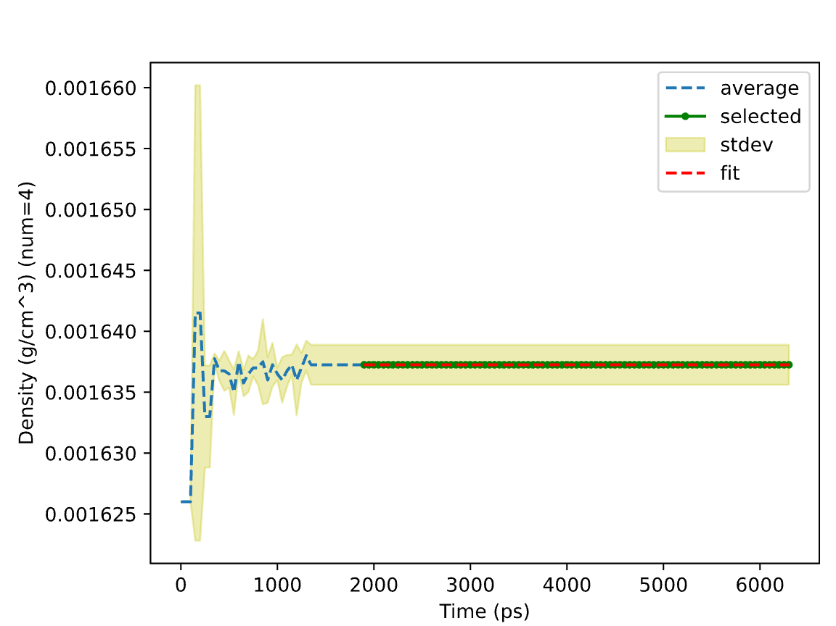
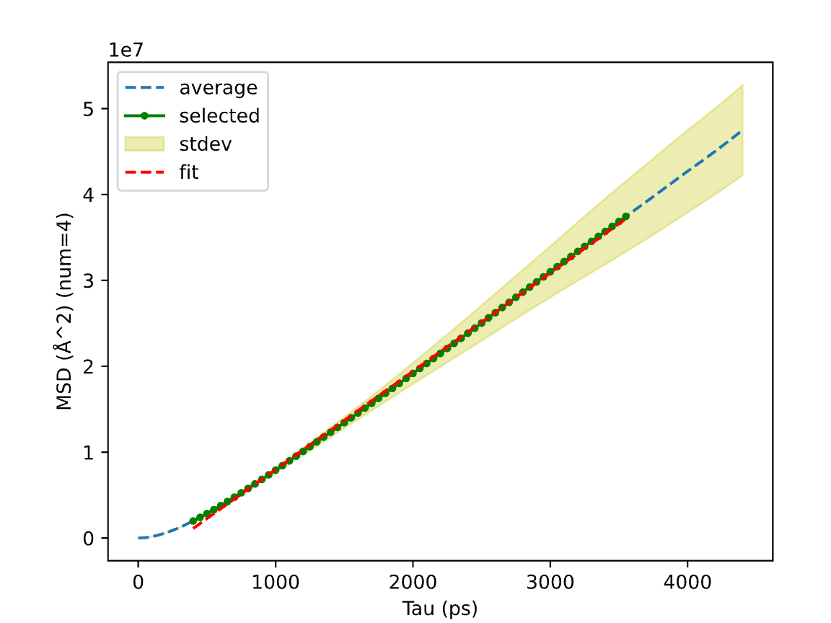
Scientific Test
https://www.engineeringtoolbox.com/argon-density-specific-weight-temperature-pressure-d_2089.html
https://doi.org/10.6028/NIST.TN.2279
13: Argon Gas Density and Mean Squared Displacement
1.637 vs 1.603 kg/m³
(300 K, 1 bara from ref)
Diffusion Coefficient:
0.191 vs 0.182 cm²/s
(298 K, 1.0 atm from ref)
1 Seeded Amorphous Builder → Molecular Dynamics → Density and Mean Squared Displacement Analyses
2 …
3 …
4 …
Fit and Report
merge

Slide 29
Command-Line Arguments
Script Flag | Description | Comment
-seed SEED | Set random state | Randomize coordinate, velocity, sequence, selection, etc.
-JOBNAME JOBNAME | Name output files | Jobname[_type].{log, csv, data, npz, parquet, etc.}
-INTERACTIVE | Pause for user input | Zoom in / out figure, set initial guess, etc.
-PYTHON {-1,0,1,2} | 0: native; 1: compiled; 2: cached | High performance compiled python.
-cpu CPU [CPU ...] | Total number of CPUs [num for one task] | Limit the total resource and max single consumption
-DEBUG | Additional printing and output files | Surfaces the issues instead of prioritizing performance
Workflow Flag | Description | Comment
-jtype {task,aggregator} | Task handles calculations and registers files Aggregator collects results | High-cost tasks and light-weight aggregators can run either serially or separately.
-clean | Clean previous results | Run on top of previous results or from scratches
-screen {tqdm,progress,job,off} | Print the serialization tqdm, parallelization progress, and job details | Run batch script silently or with selected printing
-DEBUG [{True,False}] | Additional printing and output files | Set or let the sub-jobs set the debug mode
export SHALLOW=1 increases the performance at the sacrifice of stability. (e.g. shallow copy, unclean build)

Slide 30
Thoughts
Before reading more literatures on force field development:
Structure Generation: supported structures
DFT Calculation: accuracy vs cost
Force Constant Fit: Energy + Formula → Parameters
Typer: Type the atoms by matches, bonding, and neighbors
Assignment: assign parameters based on the types
https://mattermodeling.stackexchange.com/questions/8932/what-are-some-open-source-codes-that-can-generate-potentials

